Slide 1
Trie based dictionary for Chinese
Group member: Daixuan Chen, Shulin Wen, Fan Zhang

Slide 2
Pinyin Trie

Slide 3
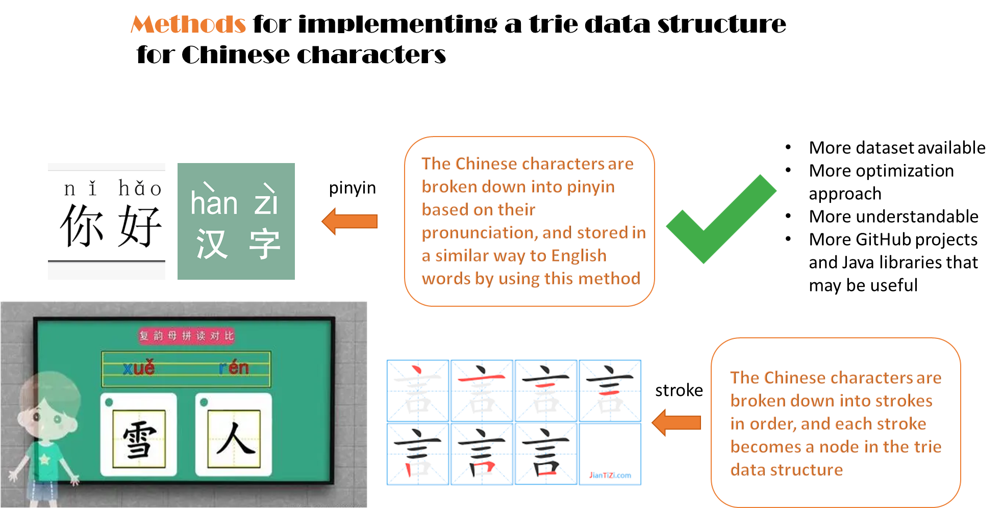

Slide 4
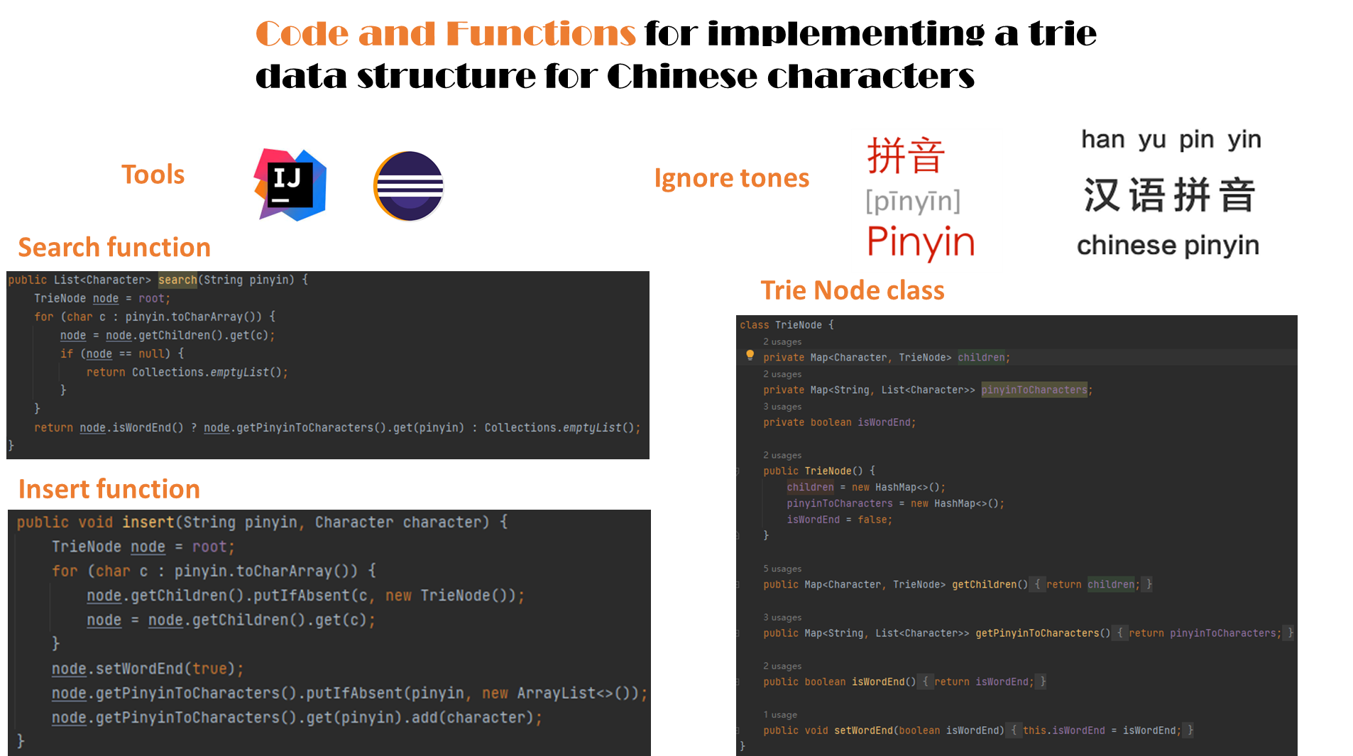

Slide 5
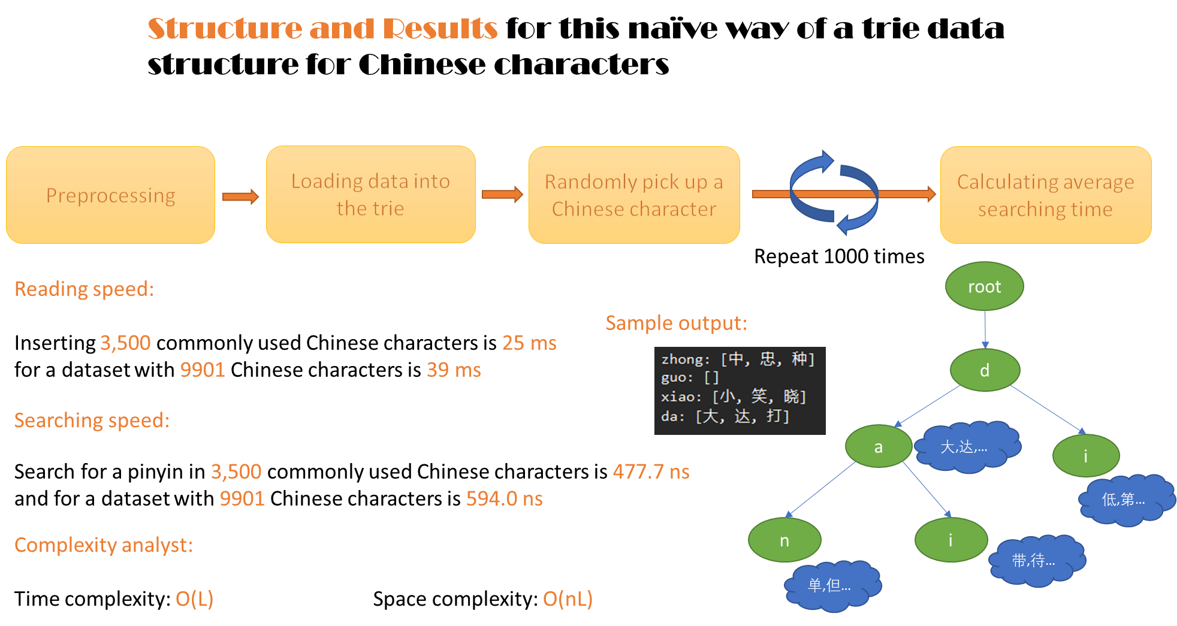

Slide 6
Shuangpin Trie

Slide 7
What is Shuangpin（双拼）
shuang（双）-double
Break Pinyin down into two parts： vowel and consonant
use single letter to represent each part
sh uang
u l

Slide 8
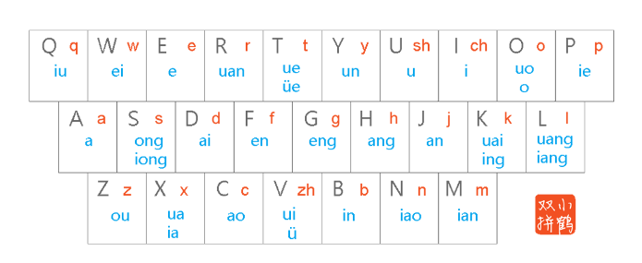
How does Shuangpin work
vowel
consonant

Slide 9
The advantage of Shuangpin
root
s
root
h
3
7
u
u
l
a
n
g

Slide 10
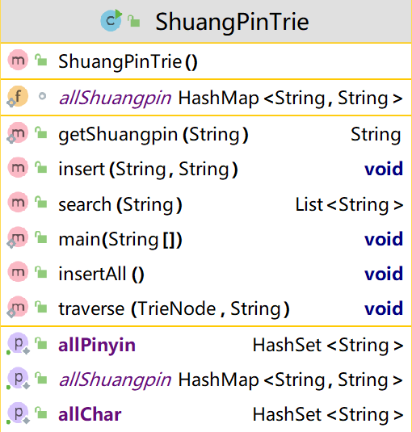
The implement of ShuangpinTrie

Slide 11
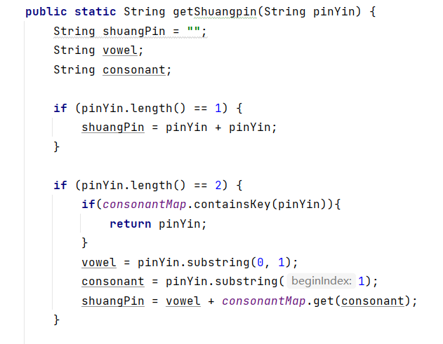
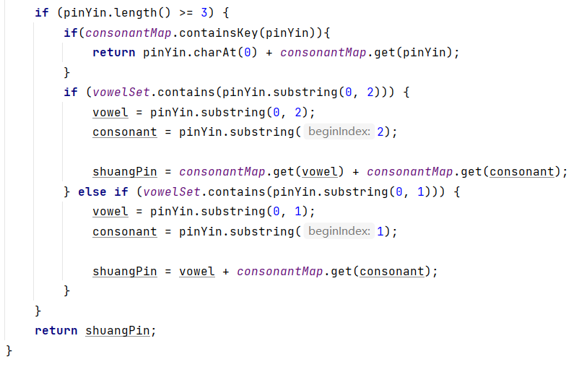
The implement of ShuangpinTrie

Slide 12


The performance of ShuangpinTrie
pinyin
shuangpin

Slide 13
Complexity Analysis
Pinyin: O(n)
Shuangpin: O(n)

Slide 14
Related Work

Slide 15
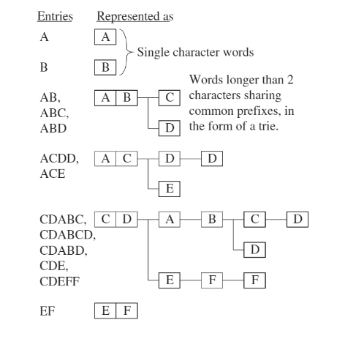
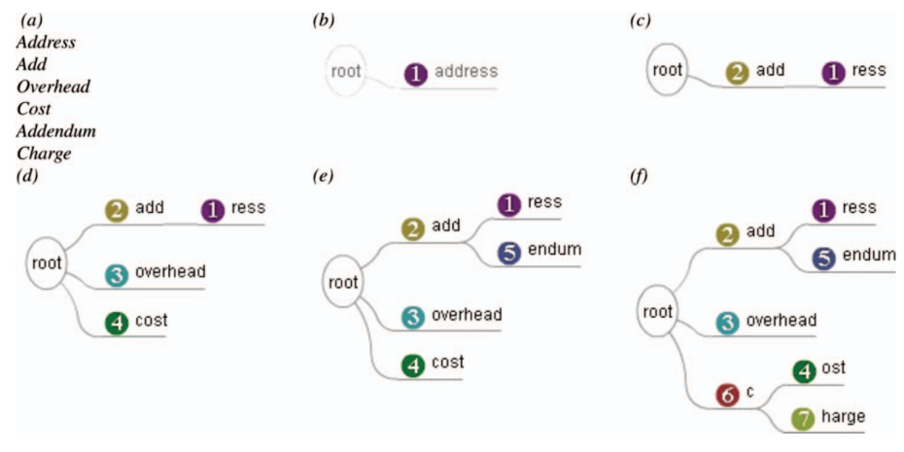
A data structure using hashing and tries for efficient chinese lexical access.
An enhanced dynamic hash TRIE algorithm for lexicon search

Slide 16
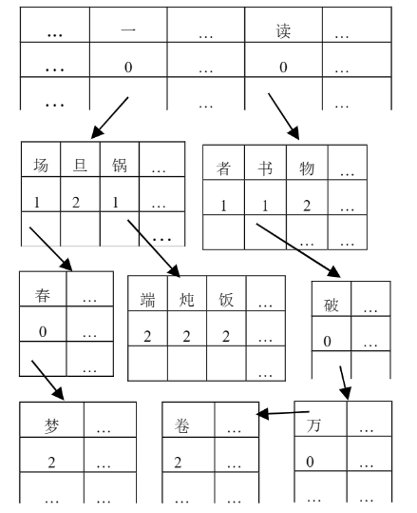
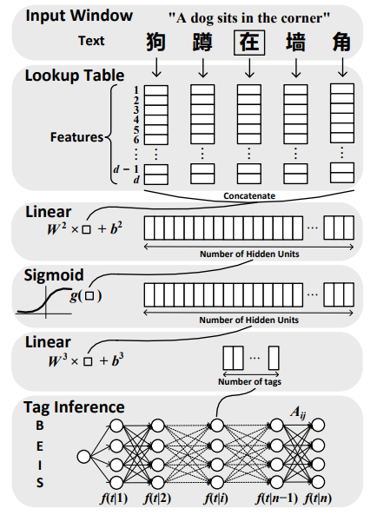
An Algorithm Rapidly Segmenting Chinese Sentences into Individual Words
Deep Learning for Chinese Word Segmentation and POS Tagging

Slide 17
Reference

Slide 18
Reference
Unihan Database, https://www.unicode.org/charts/unihan.html
pinyin4j GitHub repository, https://github.com/belerweb/pinyin4j
Chang, C. C., Chen, T. S., & Lin, Y. (2000, November). An efficient accessing technique of Chinese characters using Boshiamy Chinese input system. In Proceedings of the fifth international workshop on on Information retrieval with Asian languages (pp. 61-67).
Lam, Y. K., & Huo, Q. (2005, August). A data structure using hashing and tries for efficient chinese lexical access. In Eighth International Conference on Document Analysis and Recognition (ICDAR'05) (pp. 506-510). IEEE.
Yang, L., Xu, L., & Shi, Z. (2012). An enhanced dynamic hash TRIE algorithm for lexicon search. Enterprise Information Systems, 6(4), 419-432.
Zheng, X., Chen, H., & Xu, T. (2013, October). Deep learning for Chinese word segmentation and POS tagging. In Proceedings of the 2013 conference on empirical methods in natural language processing (pp. 647-657)
Flypy: A Shuangpin Input Method for Chinese. Retrieved from https://www.flypy.com/

Slide 19
Thank you for your attention

